Slide 1
OPTIMIZED AMPLIFIER PLACEMENT
Capgemini POC

Slide 2
USER
01
NODE
02
MODULES
NETWORK
04
CIRCUIT
03
User specific taks like logging in and registering
Nodes along with their edges, links and more
Overall network that binds the other modules
Circuits of nodes from source to destination node and their paths

Slide 3
DESIGN REQUIREMENT
The goal here is to place amplifiers on each node for both pre and booster position so that the signal which starts from source needs to reach destination considering the losses on entering/Exiting each edge and link loss.
Each node is connected by Link/Fibre. Link/Fibre based on length of Link, they will have signal loss. (0.25*length = loss of Link).
Similarly, when signal is passed on each edge, they will have loss of 12 db.
This Edge loss is applicable only for Add/Drop Nodes not ILA or Pass-through nodes.

Slide 4
OVERALL PROCEDURE
Model Layer
Service Layer
Controller Layer
Axios
React Router
Component-based
Back End
Testing
Mapping the Entitities
and forming relationships between them
Creating Service classes with their Implementations as well as logging
Creating Restful APIs and
Connecting the microservices
Writing Unit Test Cases as well as testing the APIs
Front End
Styling
Styling the components using MDB and adding Finishing touches, test cases
Using axios to write the API services and for testing the APIs as well
Implementing Routing and Links using react-router-dom
Defining Basic pages and components

Slide 5
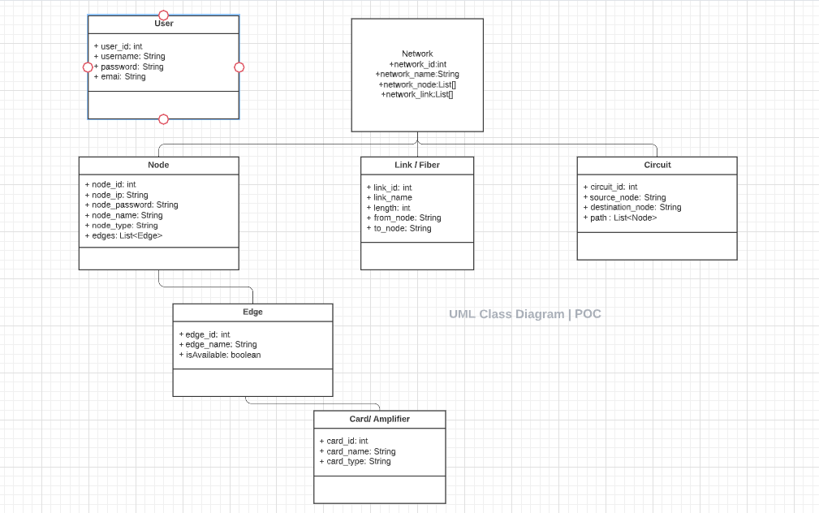
UML CLASS DIAGRAM

Slide 6



LINKS
GITHUB 1
LUCIDCHART
GITHUB 2

Slide 7
Thank You!

